Slide 1







Hackimon – Our team member
Hi! I am Krystal. I am Global Portfolio Manager in RBWM
Hi! I am KK. I am Infrastructure Lead in Group Function.
Hi! I am Michael working as Senior Lead Solution Architect for GLCM and Payment System in ASP.
Hi! I am Catherine. I am working in GLTCM for BI projects.
Hi! I am Nick,. I am Business Analyst working in data visualization projects.
Hi! I am April. I am Development Manager working in Qlik Sense projects.
Why we join?
Hackademy is a good learning program.
We have passion to enjoy the latest IT trend and explore the power of AI, Cloud and IoT to change the world

Slide 2
Problem Statement
Individual stock market traders have to digest thousands of research reports from many sources to capture the recommendation.
They could be newly published reports every minute. The investor has to complete the digest of the reports in a short time to make their investment decision in time.
The reports can be very sizable with lots of narrative comments which the investors wants to get the key points (i.e summary) first.
The innovation challenge 1B (submitted by GPB) echoes this demand and looks for a solution to improve customer experience based on the knowledge

Slide 3
Solution and business case
We build a chatbot solution to solve this problem so that the investor can get the summary of investment advice on their fingertips any time and anywhere instantly.
Our solution is a Google Cloud based solution making use of the Vision API to scan the research reports and use AutoML to understand the content from the reports based on the trained model.
The elastic computing power of the cloud allows the solution to digest many report at the same time and provide the summary instantly.
The machine learning power allows the solution to keep its ‘digest’ capability in pace with the latest writing style of the reports.
The chatbot interface is user-friendly and accessible from browser on the phone and computer. With the learning power of the dialogflow can make it understand the query of the investor and accommodate their query accurately.

Slide 4






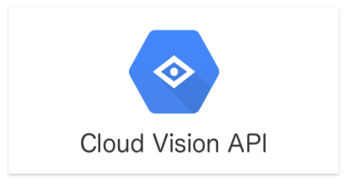





Architecture Logical Diagram
Research daily Financial report
Chatbot
Text / Voice
8. Request
Financial advice
12. Response today financial predictions
1. Upload PDF via API
Cloud Storage
10 Store / Retrieve
Prediction
Cloud Datastore
2. Trigger Cloud function
9. Run
Application
(Python)
5. Labelled Data (Stock related entities)
6. Supervised training data
3. Extract Text and convert format (using Python)
Cloud Machine learning
4. load formatted data
7. AutoML Natural Language Entity Extraction
Trained Model
Cloud Storage
Cloud AutoML

Slide 5
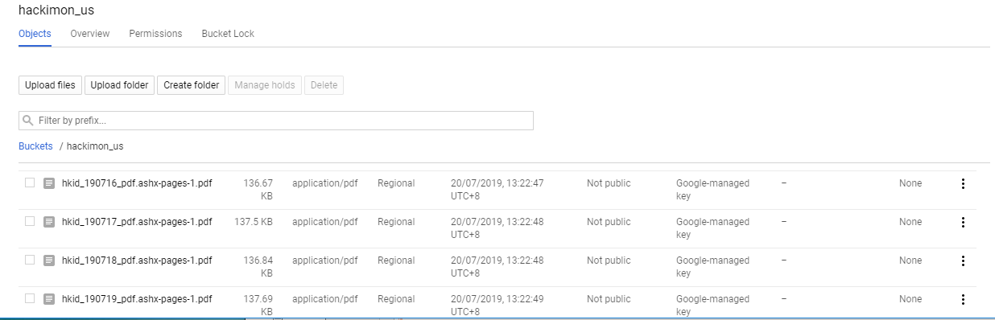
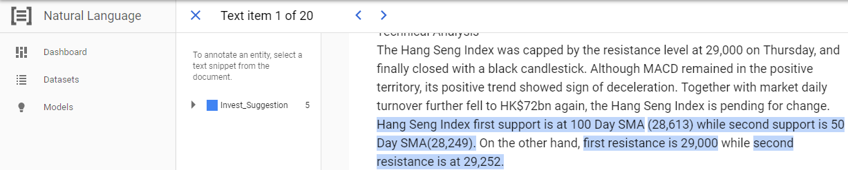
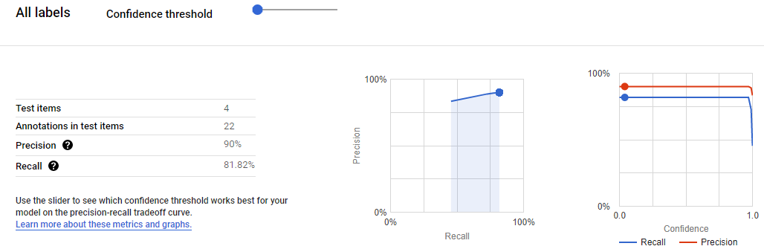
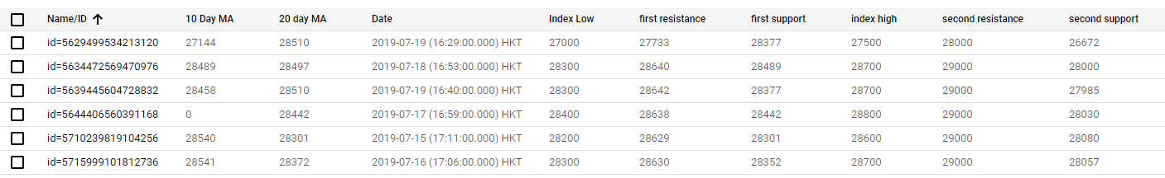
Hackimon – Machine learning
Research Reports delivered to google cloud storage and extract text to a format that fit to Google Auto ML Entity Extraction by using Python/Vision API
Annotate the entities in Auto ML Entity Extraction. The more annotation we provided, the more precise the model will be.
The model was trained/evaluated in Auto ML Entity Extraction. Perfect precision and recall can indicate that the data is too easy and may not generalize well. Fine tuning the model to get better result.
The data was extracted to Google datastore and ready for chatbox’s queries.

Slide 6
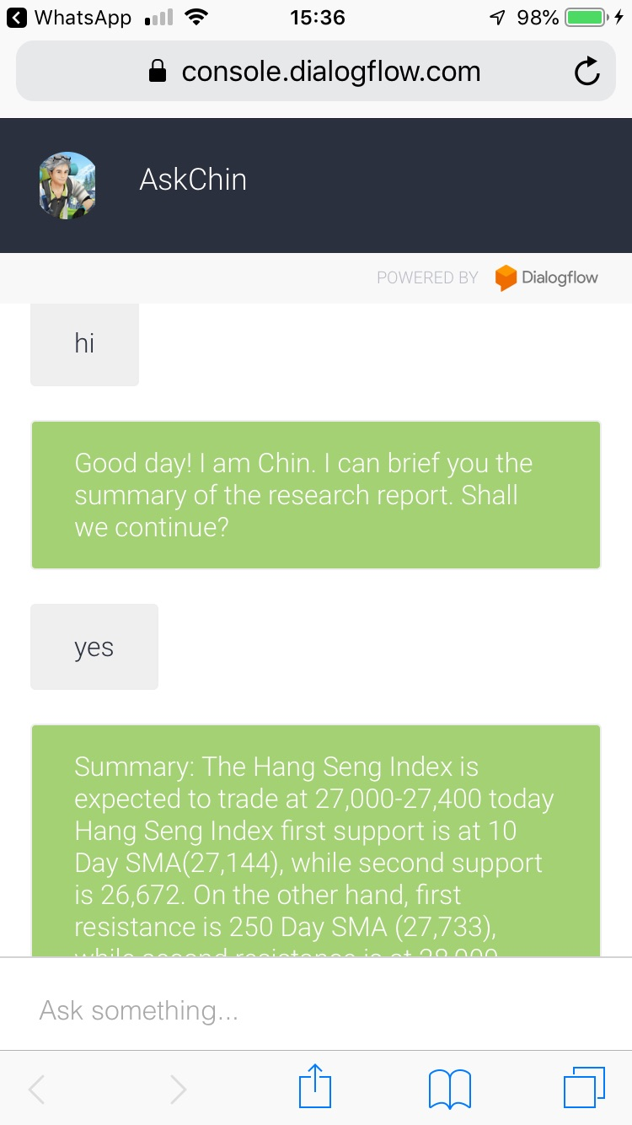
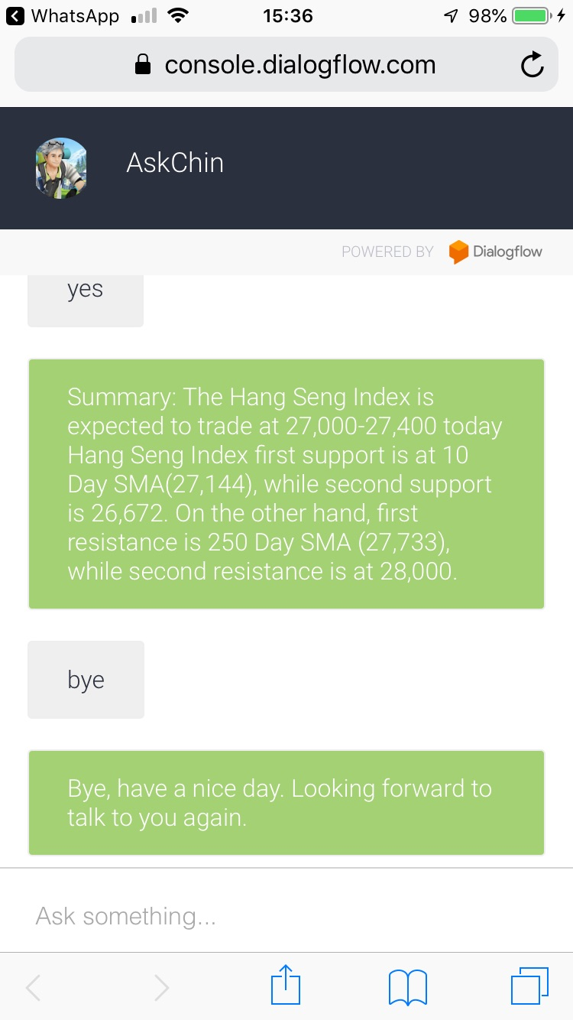
Chatbot interface
Our solution ‘AskChin’ make use of Dialogflow of GCP. Diaglogflow retrieve the summary from the nonSQL DataStore to reply the investor at once.
It adapt to the tone of the investor by its continuous learning model.
The solution can be further extended to support non-English conversation to meet a much wider population of investors,

Slide 7
Hackimon – Our team member
Hi! I am Krystal. I am Global Portfolio Manager in RBWM
Hi! I am KK. I am Infrastructure Lead in Group Function.
Hi! I am Michael working as Senior Lead Solution Architect for GLCM and Payment System in ASP.
Hi! I am Catherine. I am working in GLTCM for BI projects.
Hi! I am Nick,. I am Business Analyst working in data visualization projects.
Hi! I am April. I am Development Manager working in Qlik Sense projects.
Why we join?
Hackademy is a good learning program.
We have passion to enjoy the latest IT trend and explore the power of AI, Cloud and IoT to change the world

Slide 8
Hackimon – Our team member
Hi! I am Krystal. I am Global Portfolio Manager in RBWM
Hi! I am KK. I am Infrastructure Lead in Group Function.
Hi! I am Michael working as Senior Lead Solution Architect for GLCM and Payment System in ASP.
Hi! I am Catherine. I am working in GLTCM for BI projects.
Hi! I am Nick,. I am Business Analyst working in data visualization projects.
Hi! I am April. I am Development Manager working in Qlik Sense projects.
Why we join?
Hackademy is a good learning program.
We have passion to enjoy the latest IT trend and explore the power of AI, Cloud and IoT to change the world

Slide 9
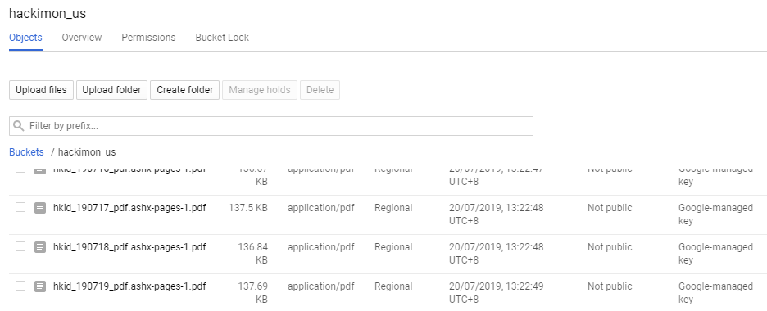
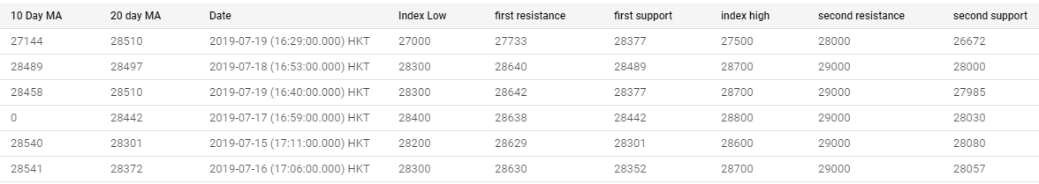
Hackimon – Machine learning
Research Reports delivered to google cloud storage and extract text to a format that fit to Google Auto ML Entity Extraction by using Python/Vision API
Annotate the entities in Auto ML Entity Extraction. The more annotation we provided, the more precise the model will be.
The model was trained/evaluated in Auto ML Entity Extraction. Fine tuning the model by checking the precision and recall.
The data was extracted to Google datastore and ready for chatbox’s queries.

Slide 10
Architecture Logical Diagram
Research daily Financial report
Chatbot
Text / Voice
8. Request
Financial advice
12. Response today financial predictions
1. Upload PDF via API
Cloud Storage
10 Store / Retrieve
Prediction
Cloud Datastore
2. Trigger Cloud function
9. Run
Application
(Python)
5. Labelled Data (Stock related entities)
6. Supervised training data
3. Extract Text and convert format (using Python)
Cloud Machine learning
4. load formatted data
7. AutoML Natural Language Entity Extraction
Trained Model
Cloud Storage
Cloud AutoML

Slide 11
Hackimon – Machine learning
Research Reports delivered to google cloud storage and extract text to a format that fit to Google Auto ML Entity Extraction by using Python/Vision API
Annotate the entities in Auto ML Entity Extraction. The more annotation we provided, the more precise the model will be.
The model was trained/evaluated in Auto ML Entity Extraction. Fine tuning the model by checking the precision and recall.
The data was extracted to Google datastore and ready for chatbox’s queries.

Slide 12
Architecture Logical Diagram
Research daily Financial report
Chatbot
Text / Voice
8. Request
Financial advice
12. Response today financial predictions
1. Upload PDF via API
Cloud Storage
10 Store / Retrieve
Prediction
Cloud Datastore
2. Trigger Cloud function
9. Run
Application
(Python)
5. Labelled Data (Stock related entities)
6. Supervised training data
3. Extract Text and convert format (using Python)
Cloud Machine learning
4. load formatted data
7. AutoML Natural Language Entity Extraction
Trained Model
Cloud Storage
Cloud AutoML

